Slide 1



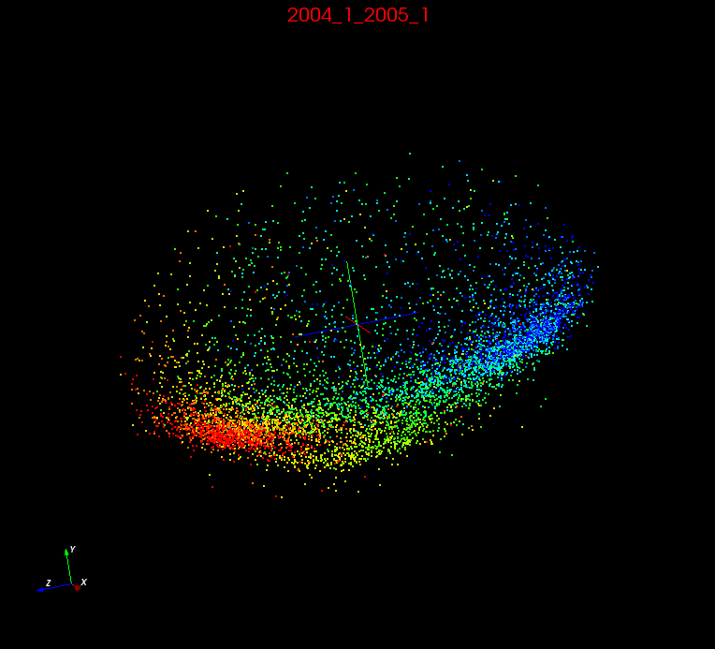
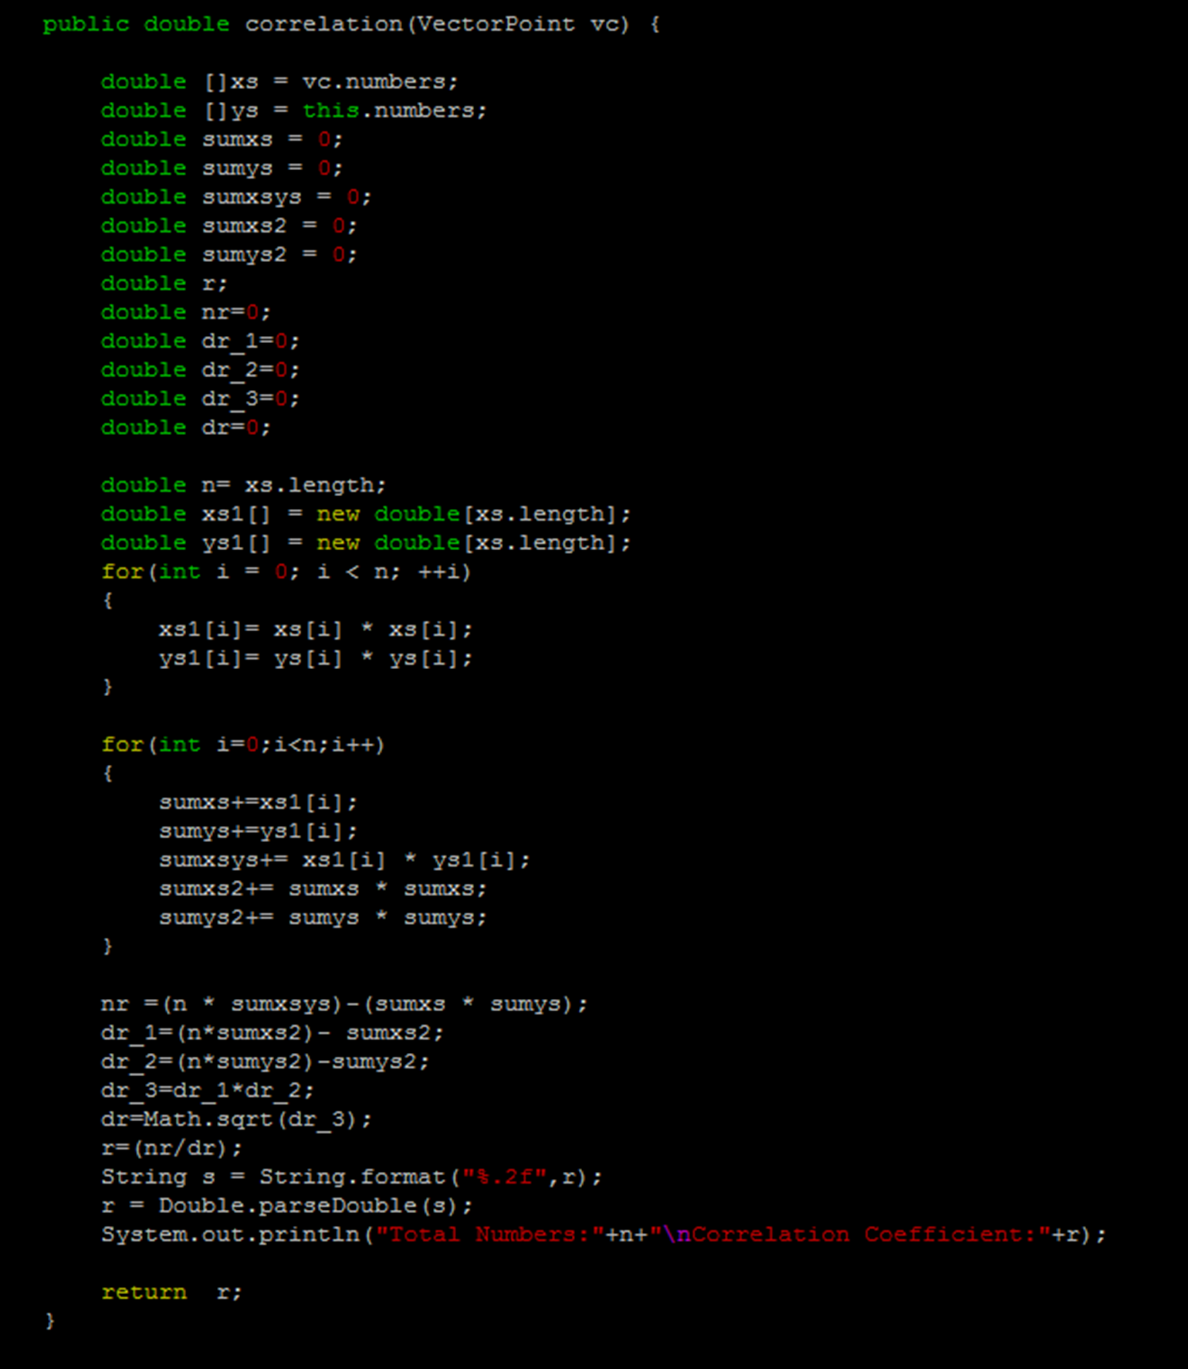
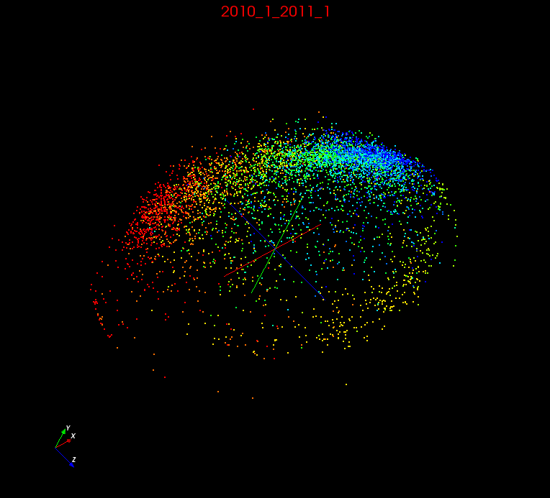
Analyzing Stock Data Using Multi-Dimensional Scaling
Maya Smith(Winston Salem State University), Anthony Scott (Winston Salem State University), Mentor: Supun Kamburugamuve (Indiana University) Principal Investigator: Dr. Geoffrey Fox (Indiana University)
abstract
methods
results
Multidimensional Scaling is a means of visualizing the level of similarity of individual cases of a dataset. It refers to a set of related ordination techniques used in information visualization, in particular to display the information contained in a distance matrix. Furthermore, a stock market is the market in which portions of publicly held companies are issued and traded either through exchanges or over-the-counter markets. Withal kenned as the equity market, the stock market is one of the most vital components of a free-market economy, as it provides companies with access to capital in exchange for giving investors a slice of ownership in the company. The stock market makes it possible to grow diminutive initial sums of currency into immensely colossal ones, and to become affluent without taking the jeopardy of starting a business or making the sacrifices that often accompany a high-paying vocation.
Implemented correlation formula into java code in Linux to determine different patterns between stock data.
Plot 1 (Year 2004)
Introduction
We describe the application of a statistical technique kenned as Multidimensional Scaling to analyze & model a stock market. To analyze such astronomically immense volume and high-dimensional scientific data, many high performance dimension reduction and clustering algorithms have been developed. Among kenned algorithms, we utilize Multidimensional Scaling (MDS) to reduce the dimension of pristine data and Pairwise Clustering, and to relegate the data.
Plot 2 (Year 2010)
conclusion
Java Correlation Code
results
In this research, we proposed simple graphical tools to visualize time-varying correlations between stock market behavior.
Stock data from years 2004 and 2010 are mapped to 3d using multidimensional scaling. The coloring shows the years change in the data. For example stocks with read are the ones with most positive change over the year and once with blue have the most negative change over the year.
Future work
Gather more stock data from different years to examine more patterns in the stocks.
Correlation Formula
References
Ruan, Yang, and Geoffrey Fox. "A Robust and Scalable Solution for Interpolative Multidimensional Scaling with Weighting." 2013 IEEE 9th International Conference on E-Science (2013): n. pag. Web.
Integration of Clustering and Multidimensional Scaling to Determine Phylogenetic Trees as Spherical Phylograms Visualized in 3 Dimensions (n.d.): n. pag. Web.

